Slide 1

Case study of Robodebt Scheme in Australia
Student name: Hongjin Gou
Student number: 510332280
hgou4823@uni.sydney.edu.au
15 April 2023

Slide 2

Contents
Introduction 3
Failure Analysis 4-6
Solutions 7-9
Reference list 10
Hongjin Gou 510332280 hgou4823@uni.sydeny.edu.au
2

Slide 3


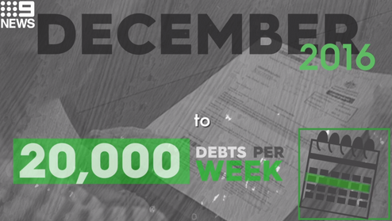


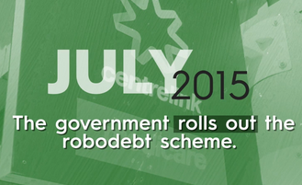
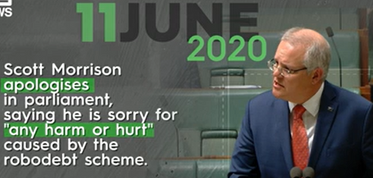
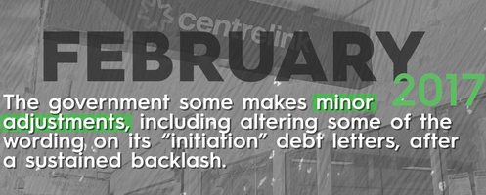

Introduction
Population identification
IPAYG data matching
Income data matching
2015
2016
2017
2019
2019
2020
Income verification and debt notification atching
( Murray 2022)
(Andrew Podger AO 2023)
Time line of the Robodebt Scheme
Stages of the Robodebt Scheme
Hongjin Gou 510332280 hgou4823@uni.sydeny.edu.au
3

Slide 4
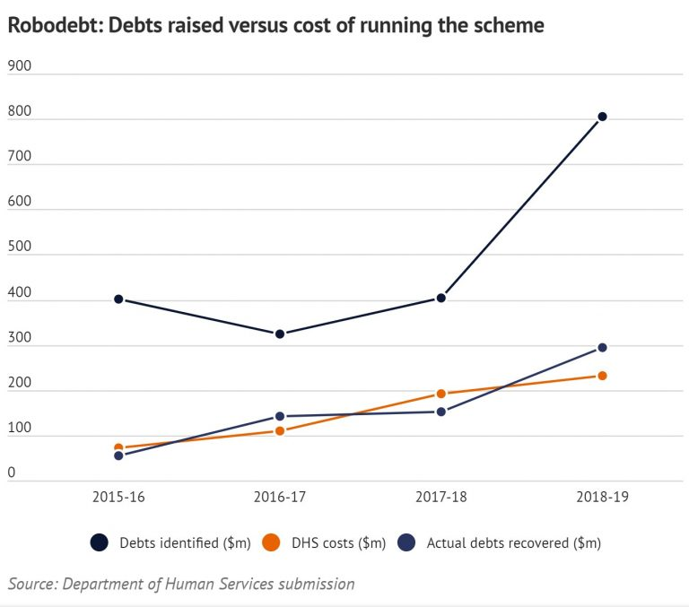
Failure AnalysisⅠ: Data Quality
Append data to CRN using TFN
2A.7 Remove TFN from Output file
2A.8 Prepare PAYG Header, Footer and Output file for DHS transmission
(Deloitte 2023)
(Giannini. 2023)
Lack of data source
Inaccurate data analysis
Hongjin Gou 510332280 hgou4823@uni.sydeny.edu.au
4

Slide 5
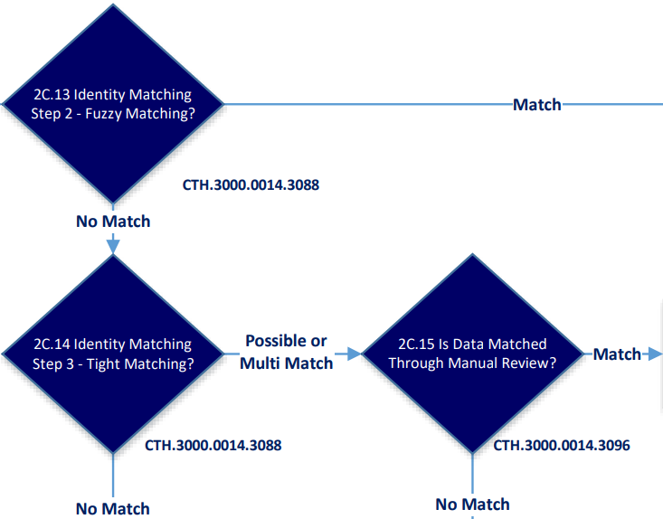
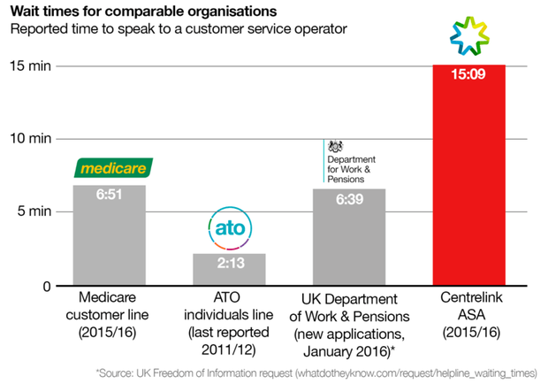
Failure AnalysisⅡ: Latency
(Deloitte 2023)
(Braithwaite. 2022, p. 243)
Data latency
Decision latency
Hongjin Gou 510332280 hgou4823@uni.sydeny.edu.au
5

Slide 6




Failure Analysis Ⅲ：Others
Cross-team collaboration challenges (Deloitte 2023)
Poor document management
(Bannister. 2023)
Lack of interaction with customers (Schiavone et al. 2022, p. 121325)
Non-compliance procedures (Deloitte 2023)
Hongjin Gou 510332280 hgou4823@uni.sydeny.edu.au
6

Slide 7


Solution Ⅰ：Data quality improvement
Completeness
Choosing
Consistency
Data quality
Tracking
Accuracy
Improving
Validity
(Chen et al. 2018, p. 4)
(Schiavone et al. 2022, p. 121325)
Hongjin Gou 510332280 hgou4823@uni.sydeny.edu.au
7

Slide 8

Solution Ⅱ：DSS
BPM (Binci et al. 2020, p.21)
Intelligence
Business process management system
GSS (Klein et al. 2007, p.2116)
Group support system
Design
Implementation
KMS (Klein et al. 2007, p.2116)
Knowledge management system
Hongjin Gou 510332280 hgou4823@uni.sydeny.edu.au
8

Slide 9




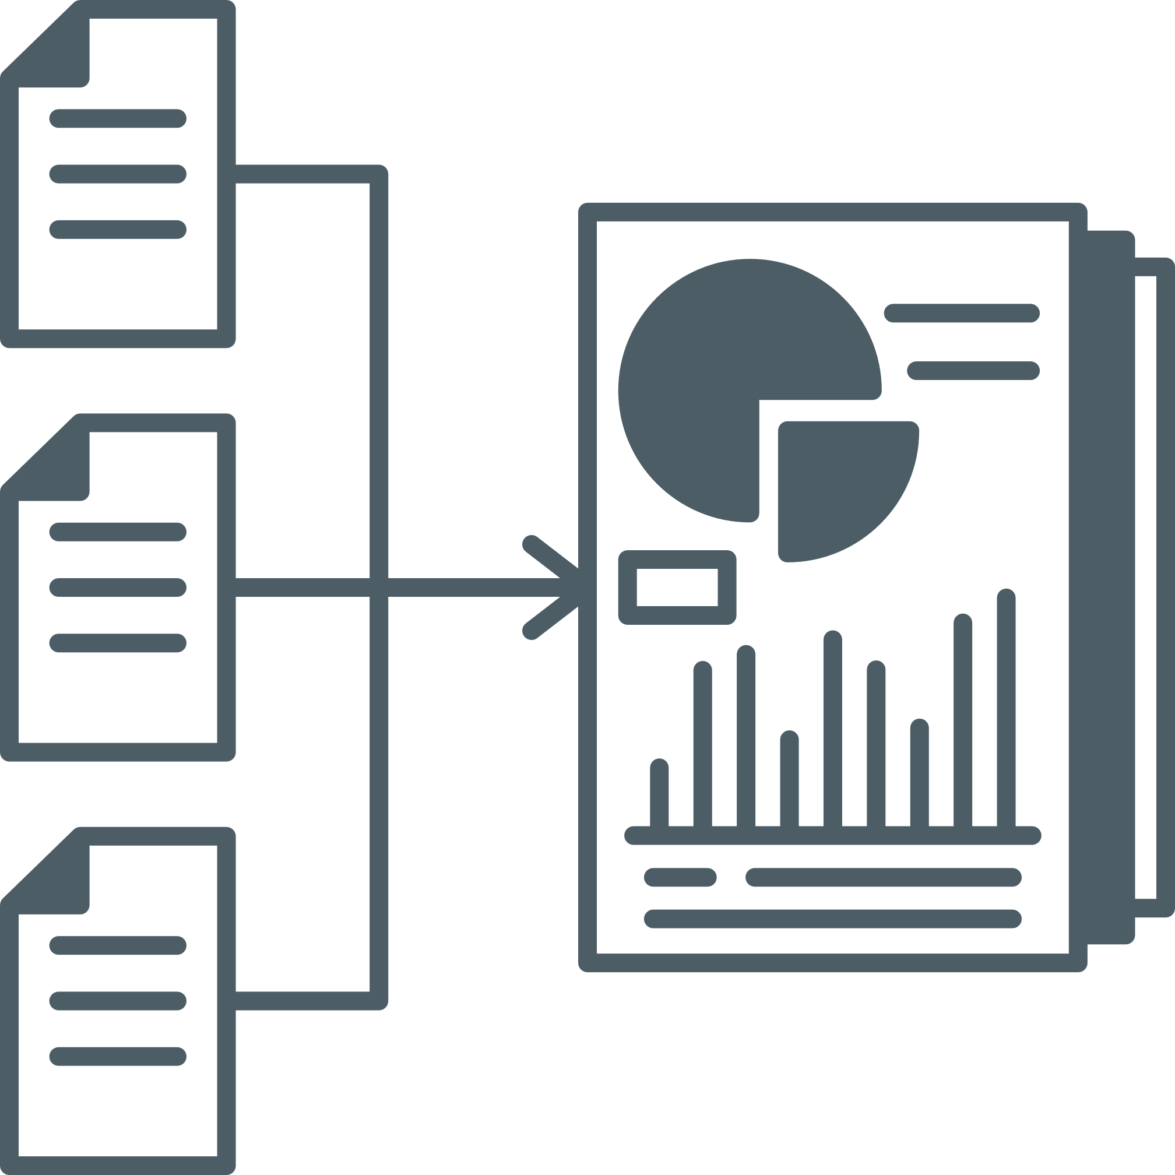

Solution Ⅲ：BI architecture
Data sources
Data warehouse
DSS
Application
ATO
BPM
Employer
Employer
GSS
Debt reporting
DHS
ETL
Data mart
Replication
(Santoro et al. 2018, p.349)
(Mohanty et al. 2013)
KMS
Hongjin Gou 510332280 hgou4823@uni.sydeny.edu.au
9

Slide 10
References
Andrew Podger AO 2023, Report to the Robodebt Royal Commission, viewed 14 April 2023, https://robodebt.royalcommission.gov.au/publications/andrew-podger-ao-report-robodebt-royal-commission
Bannister, M, 2023, External auditors of robodebt scheme face commission, Australian Associated Press Pty Limited, Sydney.
Binci, D, Belisari, S, & Appolloni, A, 2020, ‘BPM and change management: An ambidextrous perspective’, Business Process Management Journal, vol. 26, no. 1, pp. 1–23.
Braithwaite, V, 2020, ‘Beyond the bubble that is Robodebt: How governments that lose integrity threaten democracy’, The Australian Journal of Social Issues, vol. 55, no. 3, pp. 242–259.
Chen, AM, Kupelian, PA, Wang, P-C, & Steinberg, ML, 2018, ‘Development of a radiation oncology- specific prospective data registry for research and quality improvement: A clinical workflow-based solution’, JCO Clinical Cancer Informatics, vol. 2018, no. 2, pp. 1–9.
Deloitte 2023, Use of data and automation in the Robodebt Scheme, Royalcommission, viewed 14 April 2023, https://robodebt.royalcommission.gov.au/publications/andrew-podger-ao-report-robodebt-royal-commission
Deloitte 2023, Robodebt Process Maps, viewed 14 April 2023, https://robodebt.royalcommission.gov.au/publications/deloitte-robodebt-process-maps
Giannini, D, 2023, Public servants’ doubts over robodebt legality exposed, Australian Associated Press Pty Limited, Sydney.
Klein, EE, Tellefsen, T, & Herskovitz, PJ, 2007, ‘The use of group support systems in focus groups: Information technology meets qualitative research’, Computers in Human Behavior, vol. 23, no. 5, pp. 2113–2132.
Murray, D, 2022, Morrison clashes with robodebt inquiry, Australian Associated Press Pty Limited, Sydney
Mohanty, S, Jagadeesh, M, & Srivatsa, H, 2013, Big Data Imperatives: Enterprise Big Data Warehouse, BI Implementations and Analytics, 1st ed. 2013., Apress L. P, Berkeley, CA.
Santoro, G, Vrontis, D, Thrassou, A, & Dezi, L, 2018, ‘The Internet of Things: Building a knowledge management system for open innovation and knowledge management capacity’, Technological Forecasting & Social Change, vol. 136, pp. 347–354.
Schiavone, F, Leone, D, Caporuscio, A, & Kumar, A, 2022, ‘Revealing the role of intellectual capital in digitalized health networks. A meso‑level analysis for building and monitoring a KPI dashboard’, Technological Forecasting & Social Change, vol. 175, p. 121325.
Hongjin Gou 510332280 hgou4823@uni.sydeny.edu.au
10

